Slide 1
RAG
Akshay Parate

Slide 2
What is RAG ?
RAG which stands for Retrieval Augmented Generation, is a technique that enhances the accuracy and relevance of responses generated by large language models (LLMs) by allowing them to access and incorporate information from external knowledge bases, essentially providing more up-to-date and context-specific answers to queries.
Benefits:
Improved accuracy
Domain-specific expertise
Up-to-date information
Applications:
Customer service chatbots
Knowledge management systems
Research and analysis

Slide 3
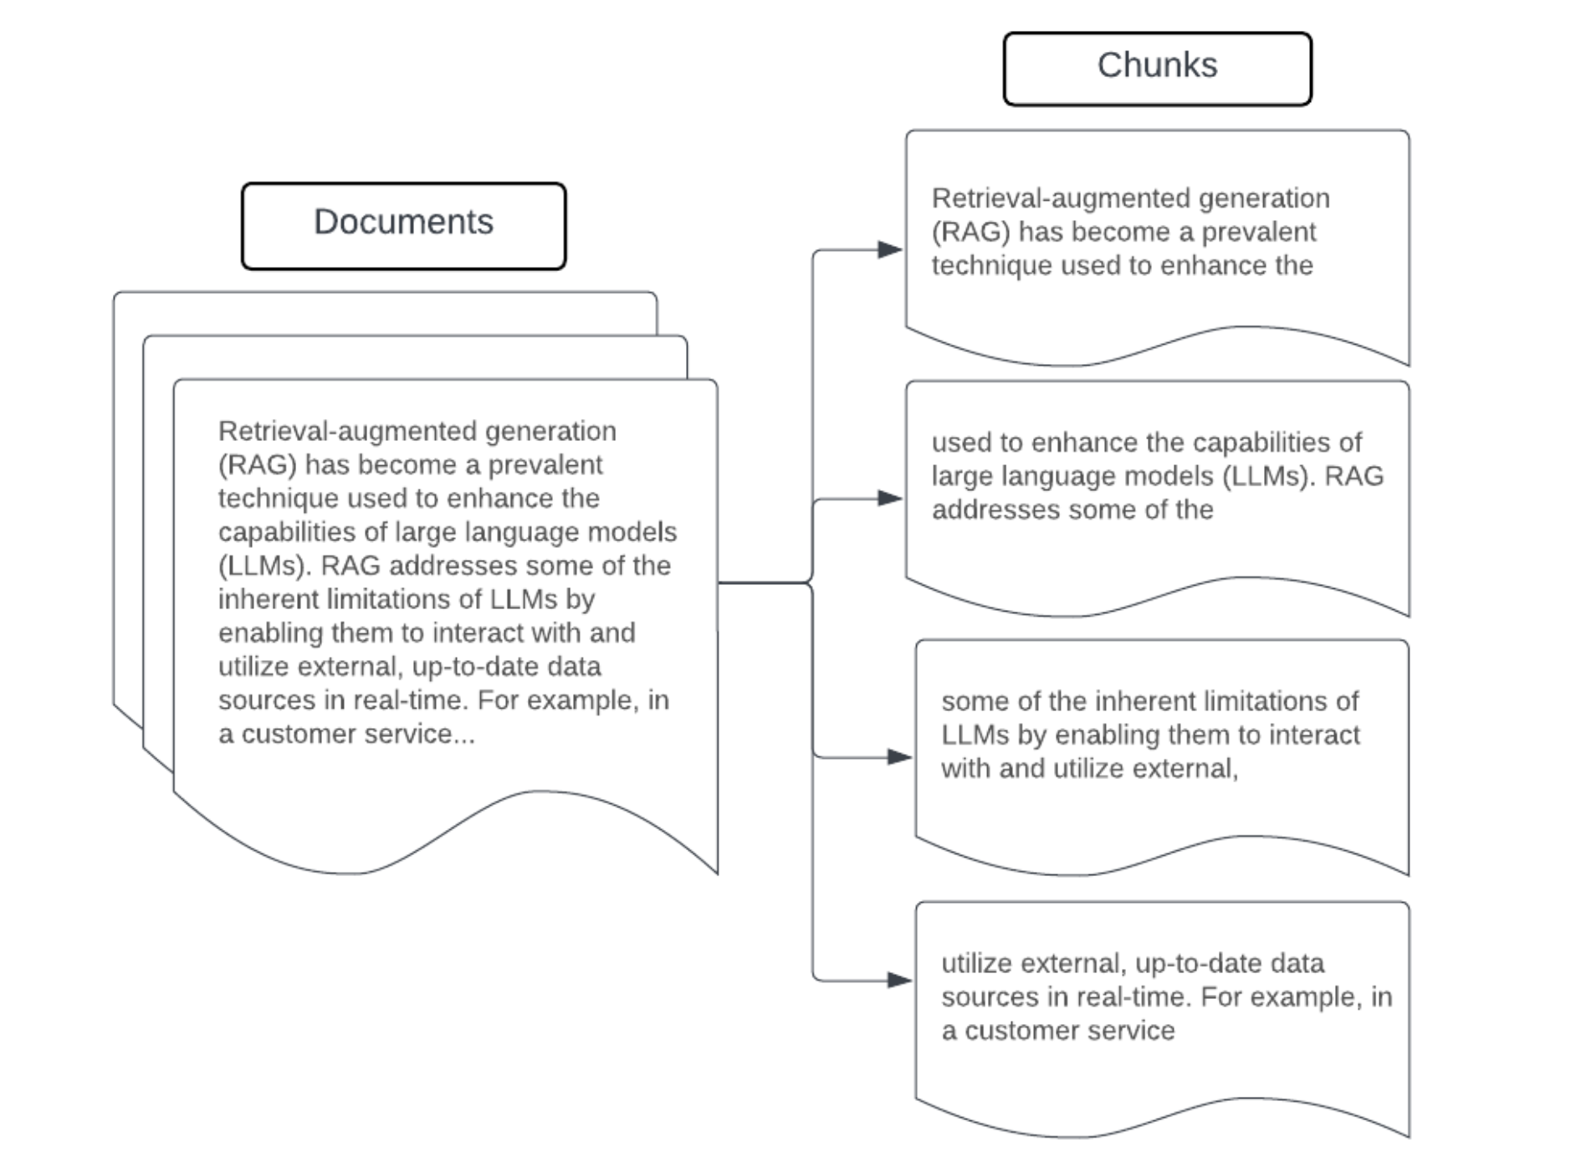
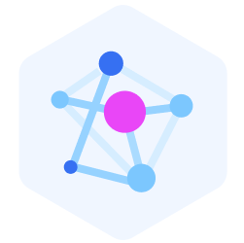

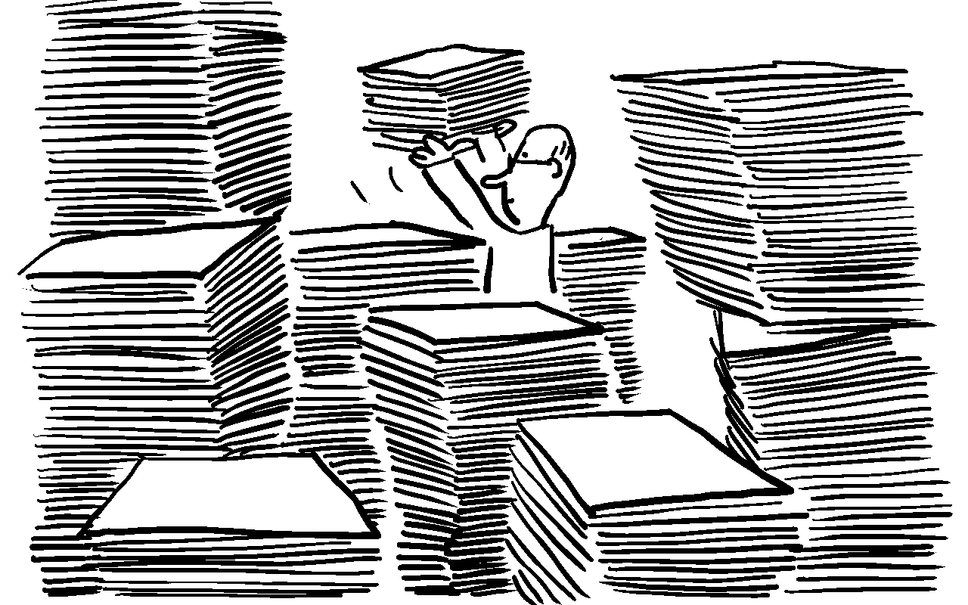
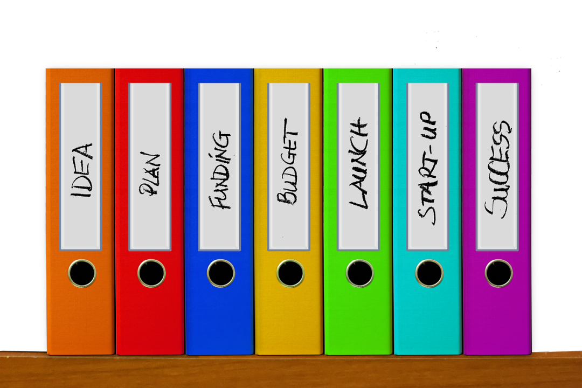
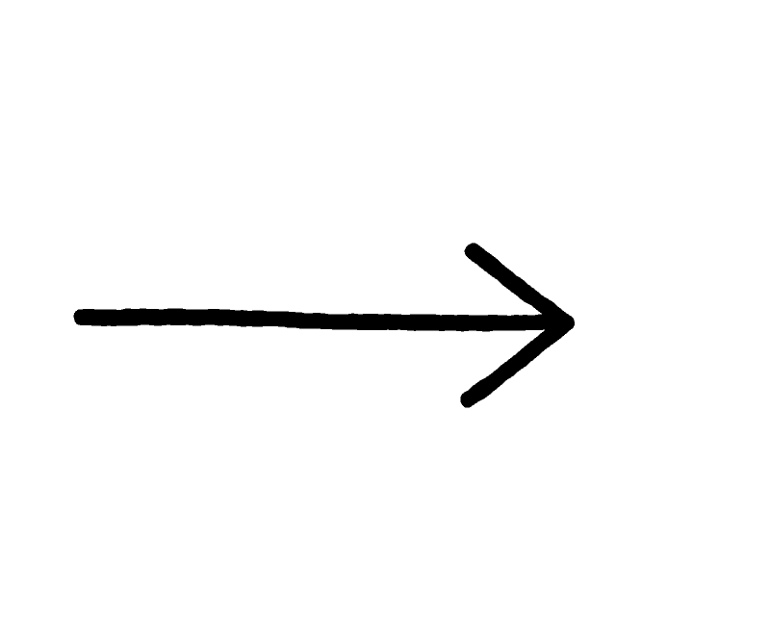
How the RAG Ingestion pipeline works?
Tons of unstructured data
Chunks of data
Vector Embeddings
Vector Database
Notes:
How the RAG Ingestion Pipeline Works?The ingestion pipeline takes unstructured data and prepares it for future retrieval. The steps include:Unstructured Data: This refers to raw data like text files, articles, or documents that lack a predefined structure.Chunks of Data: The unstructured data is split into smaller, more manageable chunks. This makes it easier to process and retrieve relevant information during the generation phase.Vector Embeddings: Each chunk is transformed into a numeric vector representation (embedding) using a model such as BERT. These embeddings are key to comparing and retrieving relevant information, as they capture the semantic meaning of the text.Vector Database: These embeddings are then stored in a vector database. This specialized database enables fast and efficient retrieval of similar vectors based on a given query.You can think of it as if you had a large collection of news articles, the ingestion pipeline would break each article into smaller sections, convert them into vectors using an embedding model, and store them in a vector database. Later, a query like "latest news on climate change" would retrieve the most relevant sections based on the vector similarity.

Slide 4
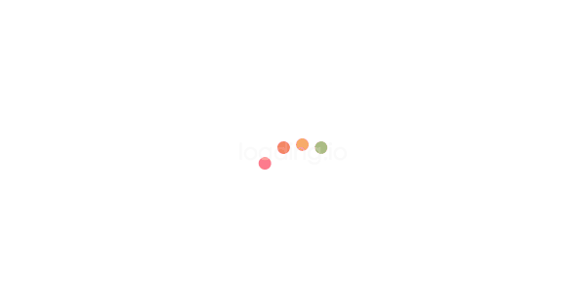




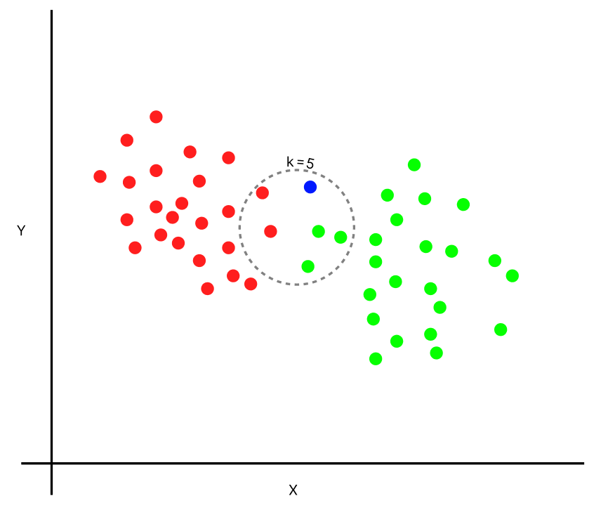
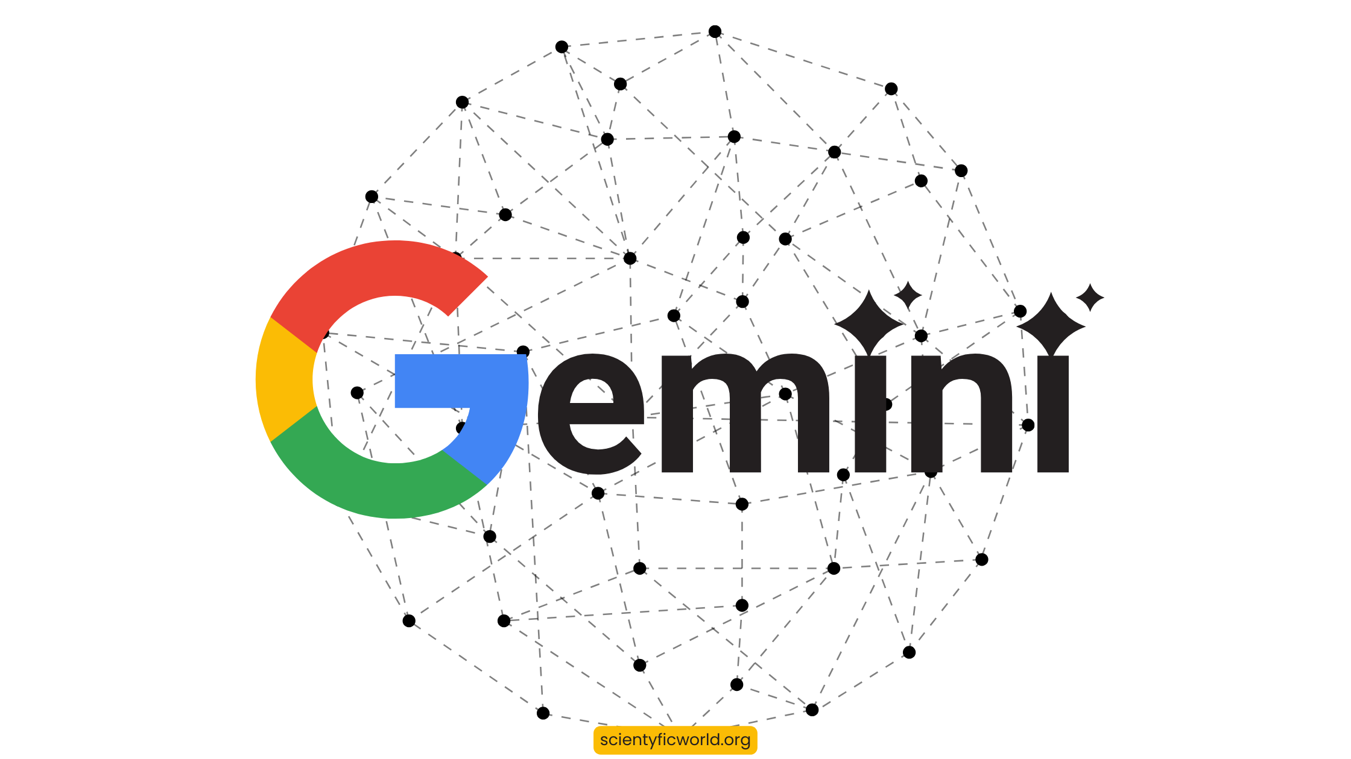

How the RAG Retrieval pipeline works?
User Query
Embedding Models
Vector Database
Vector Similarity
K Documents
LLM
Notes:
A user query or question is input into the system.The query is converted into an embedding and sent to the vector database to retrieve the top N most similar chunks of data.These retrieved chunks are passed to a language model, which generates a response using the retrieved information.lets say if a user asks, "What is machine learning?", the naive RAG would retrieve relevant chunks from the vector database (such as definitions, explanations from articles), and then generate a detailed answer by combining those chunks.

Slide 5

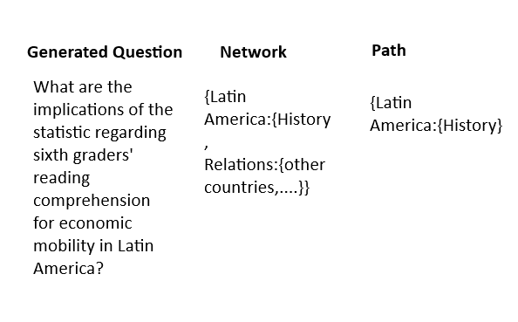
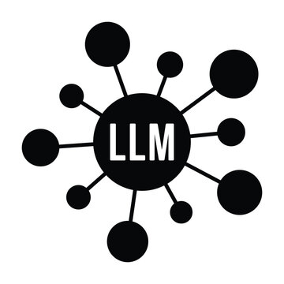
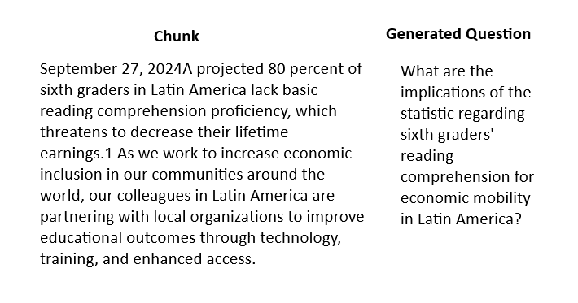
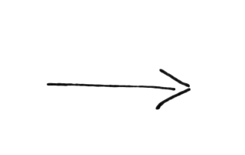
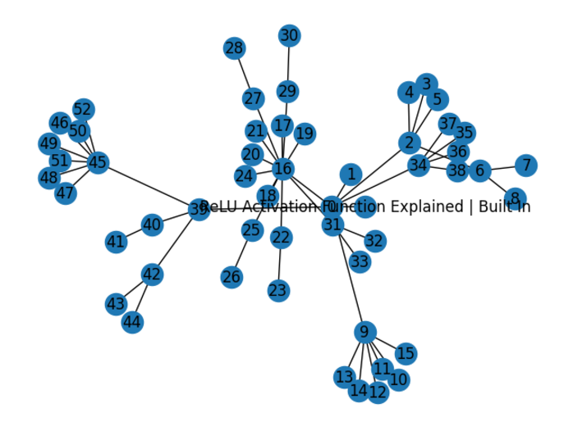


REALM : Retrieval Augmented Language Model
Data Generation
LLM
Web Crawler
Network Graph

Slide 6
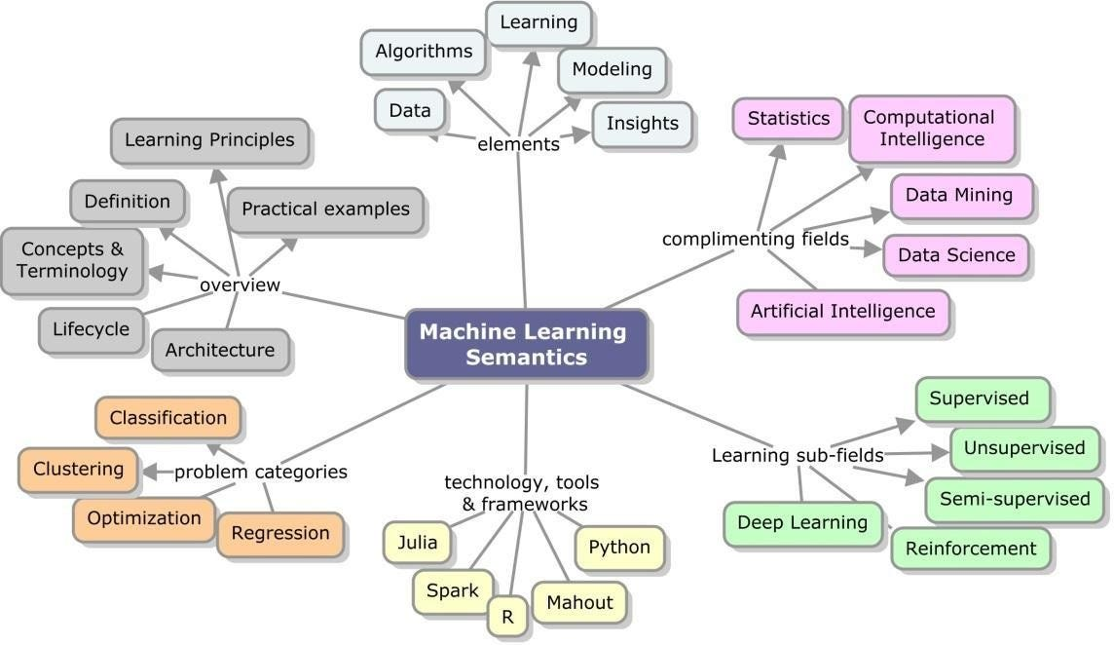
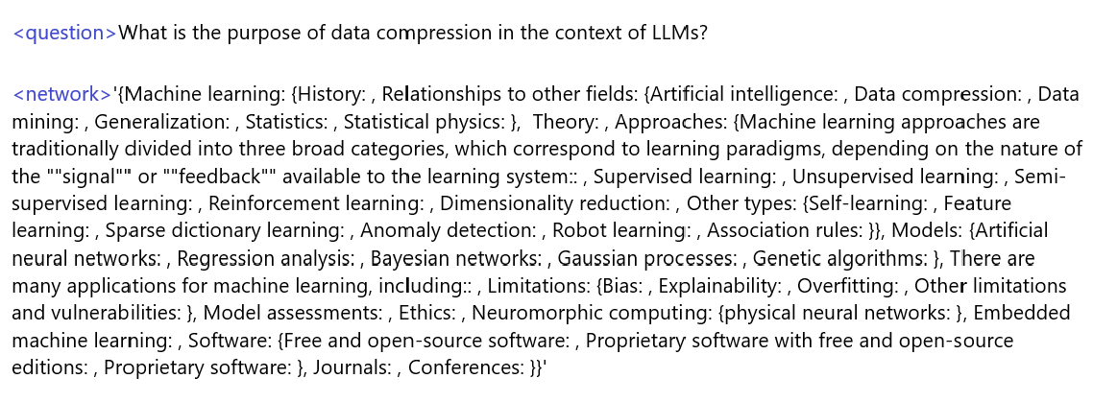
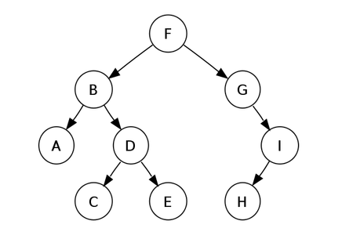


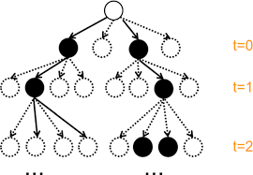
RAPTOR : Recursive Abstractive for Tree Organized Retrieval
Network Graph
User Query + Network
'Machine learning->Relationships to other fields->Data compression'
PDF / Website
REALM
Path Predictions

Slide 7
Advantages Over Vanilla RAG
Context Tracking and Detailed Explanations : Graph/tree-like structure ensures seamless context retention and enables comprehensive explanations without skipping topics (common in Vanilla RAG).
Multimodal Context Awareness : Tracks and integrates code or images within the document enhances explanations, akin to an interactive video experience.
Reduced Hallucination : Improves factual accuracy by leveraging structured context and reducing reliance on assumptions.
Enhanced Scalability : Efficiently handles large and complex datasets with better organization and retrieval capabilities.
Improved Query Understanding : Adapts to user-specific queries by dynamically navigating the graph structure for tailored responses.

Slide 8
